Slide 1
Rexroth Shaftless Drive Training

Slide 2
Synopsis:
Tirupati:
Comparison between Tirupati and MMN shaftless drives.
Tirupati Drive Configuration
Motion Logic Controller
Device Status
Parking Axis
Parameter Monitoring
Oscilloscope
MMN Chennai:
Comparison between MMN A and MMN B/C press.
MMN A Configuration
Drive Specification.
Software
Parameter Backup
OFC intensity adjustment
Encoder oscilloscope Function

Slide 3
Comparison
Tirupati
Hardware:
Single MLC is used to control all the drives in the Press.
Sercos3 communication protocol is used(Ethernet).
Dual axes inverter is used for Infeed and Drag motor.
Parking Axis is used for deactivating drives.
Software:
Indraworks
MMN Chennai
Hardware:
Each tower consists of a PPC-R which control the drives of that particular tower only.
Sercos2 communication protocol is used(OFC).
Only single axis inverter is used for all motors.
Deactivation is done through syntop.
Software:
Syntop 13 v8,Indraworks

Slide 4
Rexroth Shaftless Drive System-Tirupati Press:
In Tirupati Press, the shaftless technology is based upon Motion Logic Controller(MLC).
The MLC acts as Master and the drives act as slaves.
The main features of this MLC system include,
SERCOS III-master slave interface(LAN cables)
8MB RAM
Intel Celeron M with 1.0GHZ processor

Slide 5
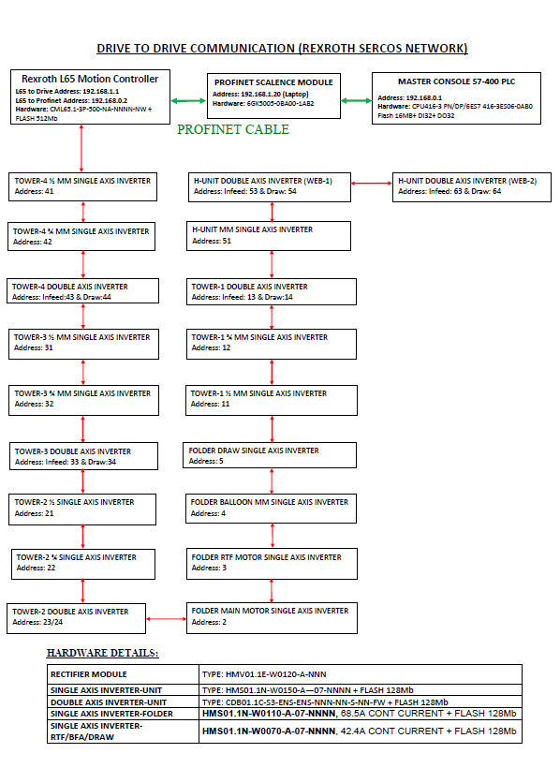
Shaftless Drive configuration Tirupati Press:

Slide 6
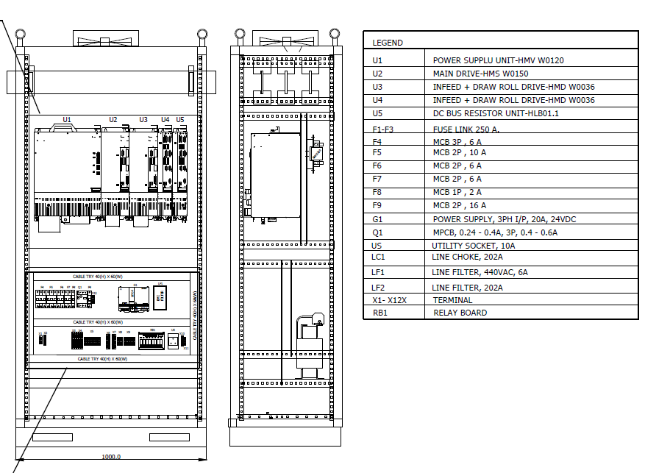

Slide 7
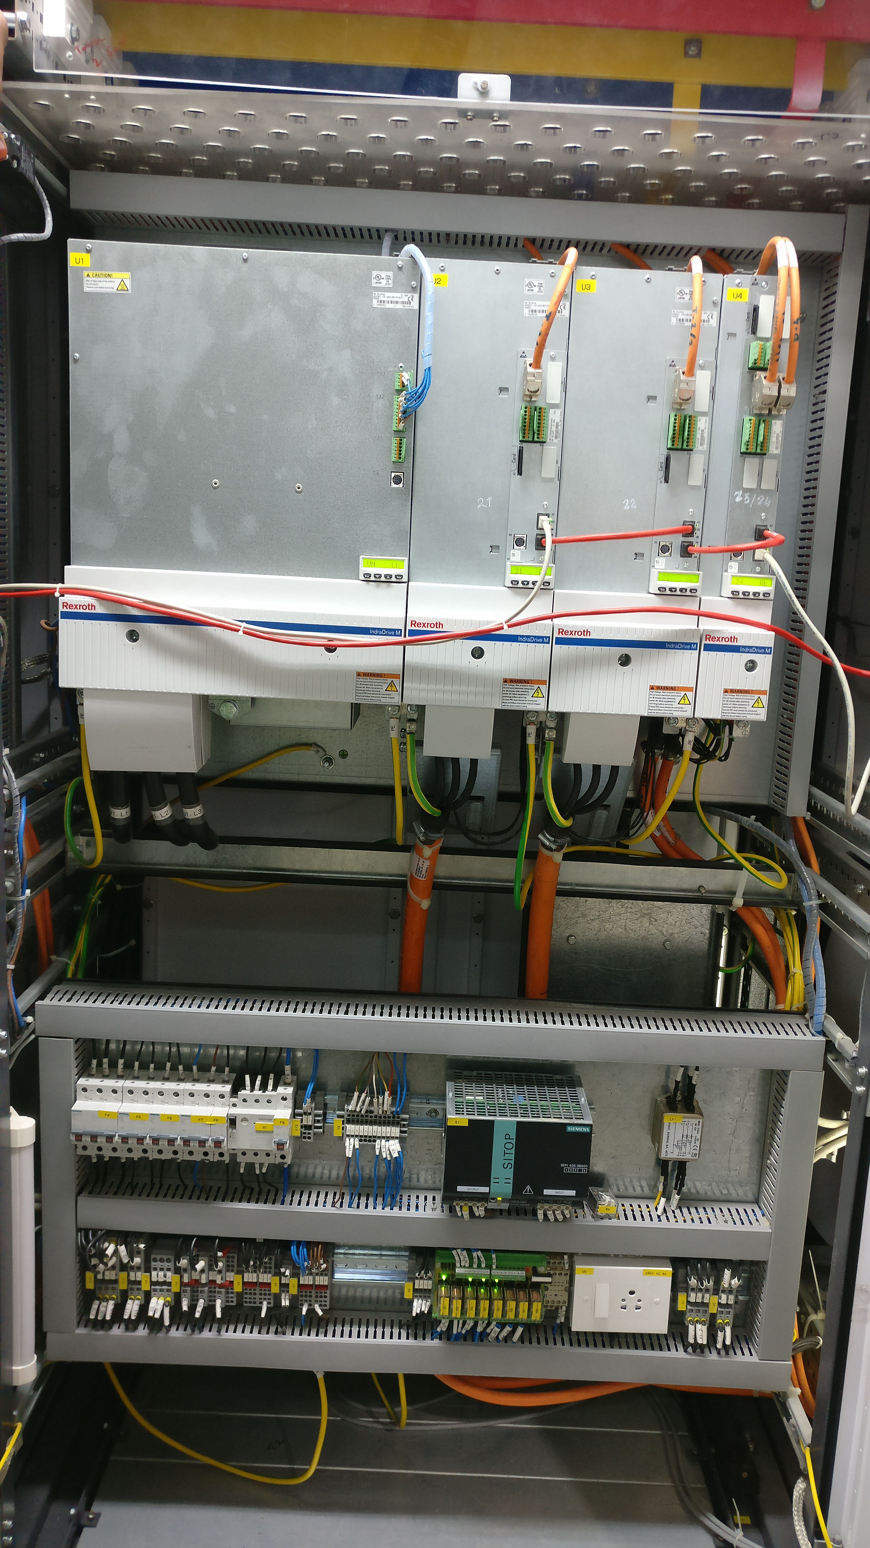
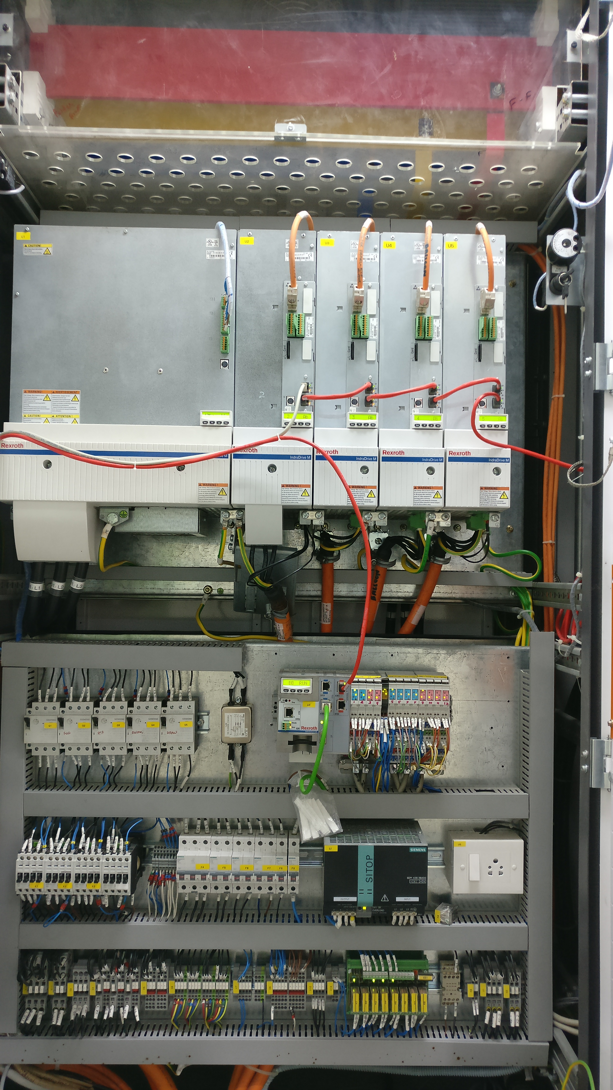

Slide 8
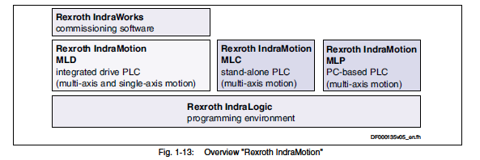
Configuration:

Slide 9
Motion Logic Controller(MLC):
L65 motion controller program can be accessed in PC through LAN network by IP address.
Program in MLC here is written using Structured text Language.
Two or three program Backups can be stored in FTP server which is available in MLC.

Slide 10
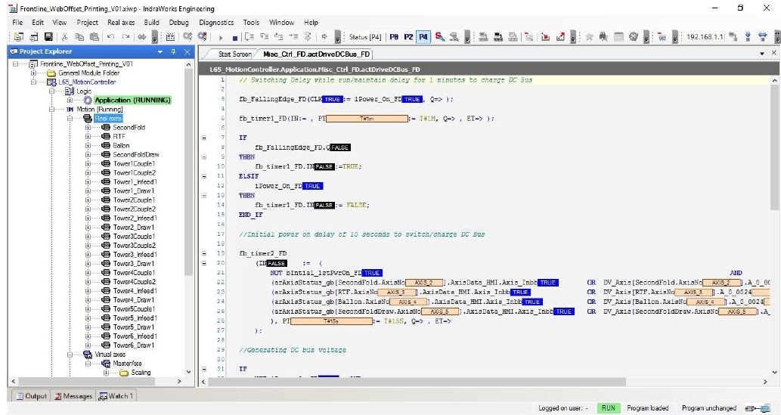
Structured text Program:

Slide 11
Drive basic Configuration:
The drive basically consists of three section. They are,
Power section
Control section
Firmware section
Single axis and dual axes inverters are used.
Dual axes is used for infeed and drag motors.
Drag motors used here are synchronous motors.

Slide 12
Monitoring Device status:
In Indraworks s/w, go to diagnostics menu and click device status option.
By Clicking device status option, you will be able to monitor the current status of all the devices connected to MLC.
From the status bit display, you can identify the following status of the devices,
S-Standstill
P-Target Position Reached
V-In velocity
R-Homed
Y-Synchronized

Slide 13
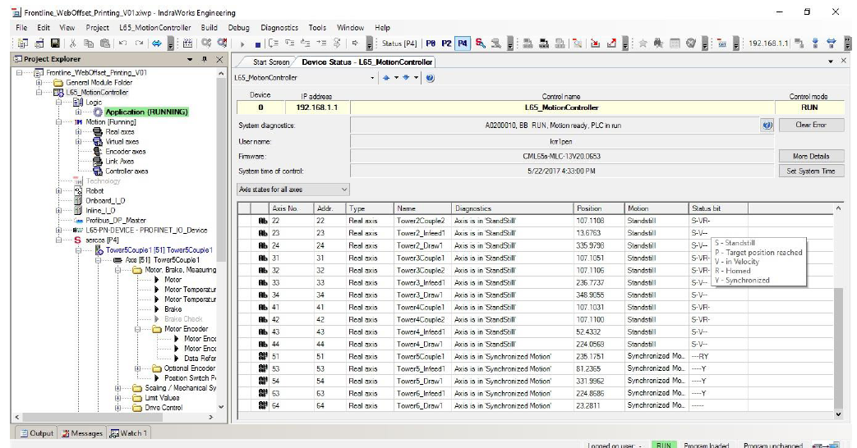
Device status:

Slide 14
Parking Axis:
It is the method used for deactivating the drive from the control loop if it has any issues.
In MLC, an option is available to park certain axis if it has any issues. All other real axes will run fine without the axis which is parked.
To Park the device right click on the particular device → Parking axis
The desired drive can be selected from the list of drives displayed.

Slide 15
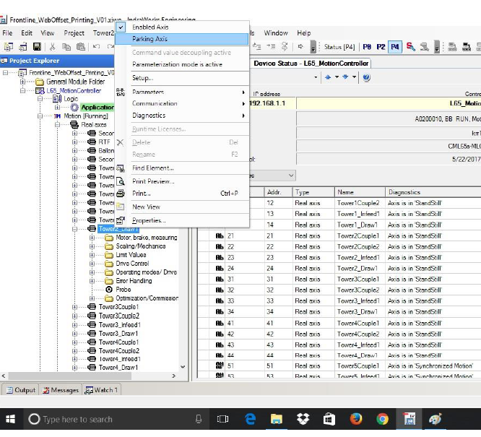
Parking axis selection:

Slide 16
Parameter monitoring:
Parameters of drives and motors can be viewed through Indraworks s/w for monitoring and diagnosis.
Click→ L65 motion controller menu
Then click parameters → Parameter Group.
The screen displays list of all the parameters and from that list you can choose the desired one.

Slide 17
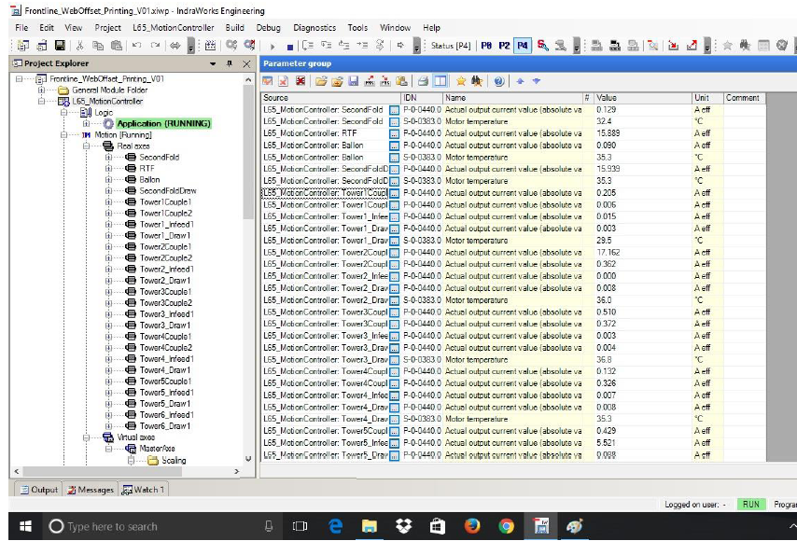
Parameter Group:

Slide 18
Oscilloscope Function:
By using the oscilloscope function, the graphical representation for each parameter can be drawn.
To use the function go to Diagnostics→ Oscilloscope.
Graphs can be viewed for single device or multiple devices by clicking the Signal option.
Three types of triggering can be used for plotting the graph. They are Automatic, Manual and Signal trigger.
After selecting trigger option, the graph is plotted as shown in the figure below.

Slide 19
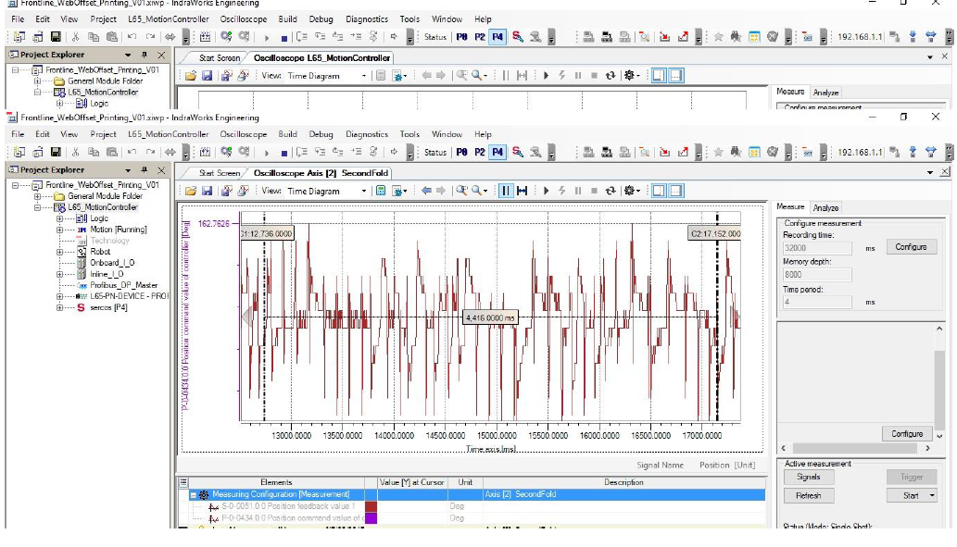
Oscilloscope Model Graph:
Inference: For diagnosis and predictive Maintenance

Slide 20
Comparison
MMN A press:
MMN B/C press:
Indradrive(Common DC bus)
Syntop 13 V8
No guide motor drives.
Firmware V13 is used in PPC-R
LED display with operation controls.
Folder RTF motor drive changed to balloon shaftless cabinet.
DKR drive (No common DC bus)
Syntop 6 v15
Guide motor drives deactivated.
Firmware V8 is used in PPC-R.
Only Error code display.

Slide 21
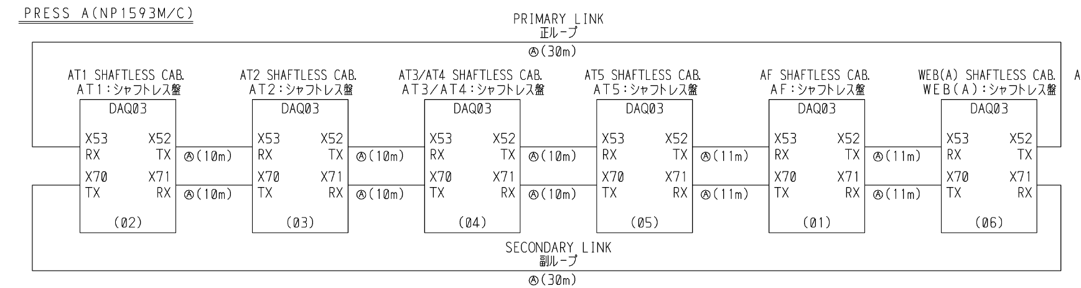
MMN Shaftless system:
PPC-R Primary Link

Slide 22
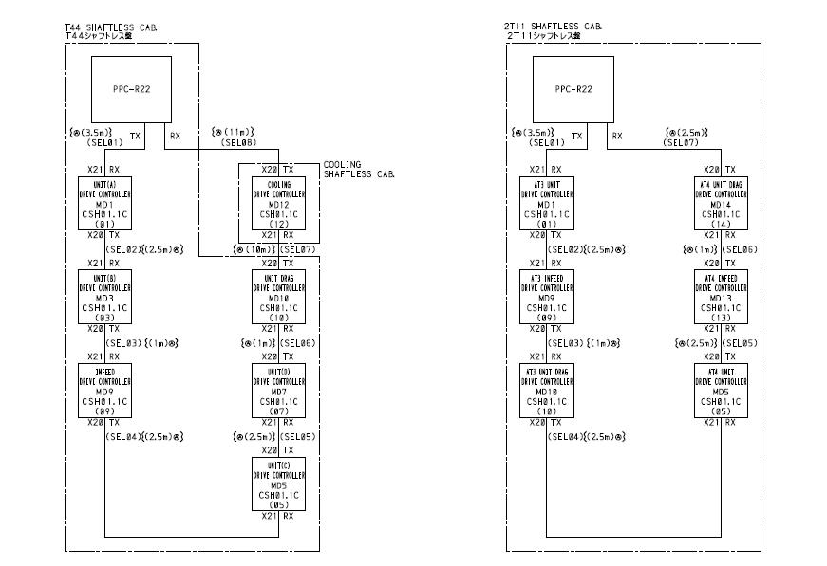
Drive Inner Loop:

Slide 23
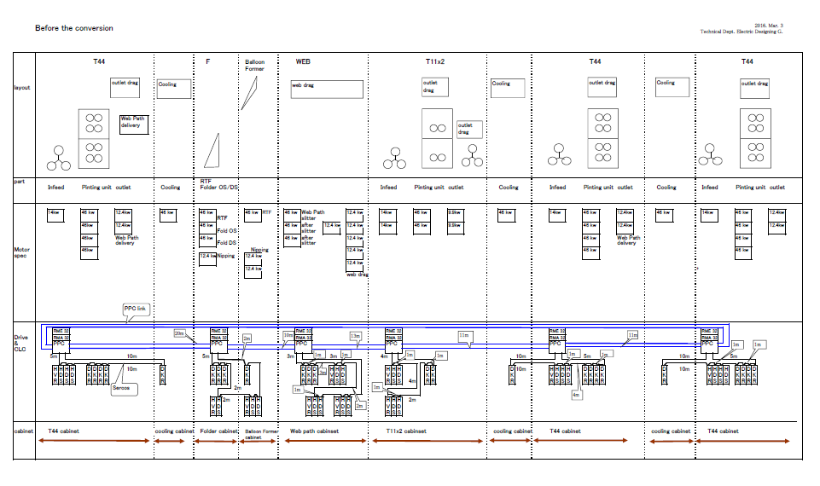

Slide 24
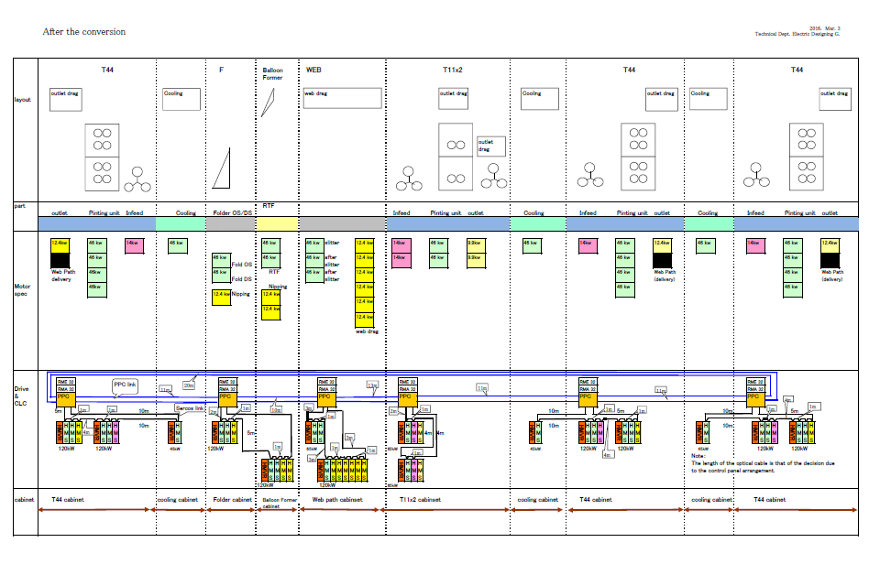

Slide 25
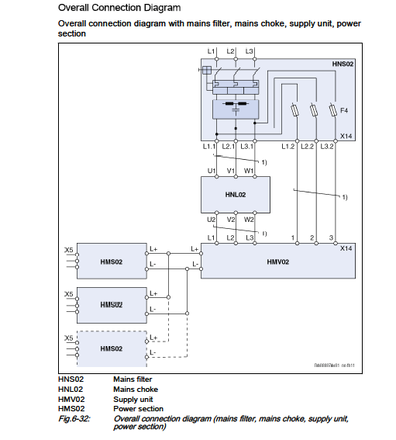

Slide 26
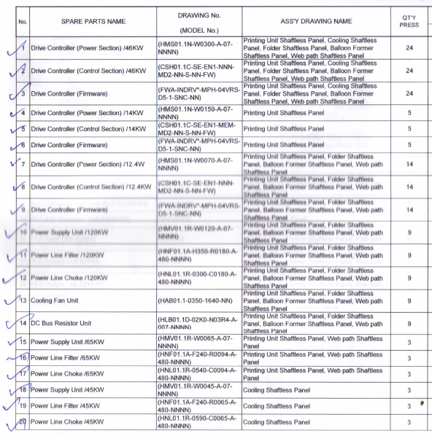

Slide 27
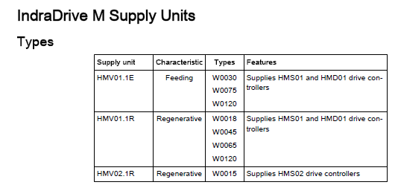
Supply Units:

Slide 28
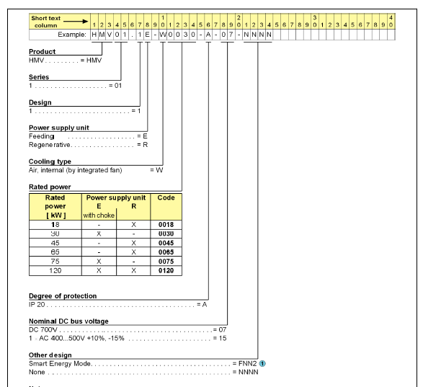
Type Plate:

Slide 29
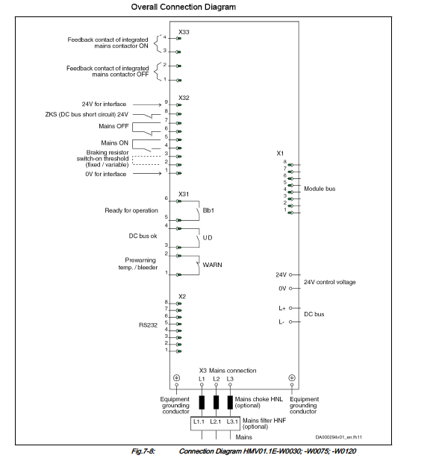

Slide 30
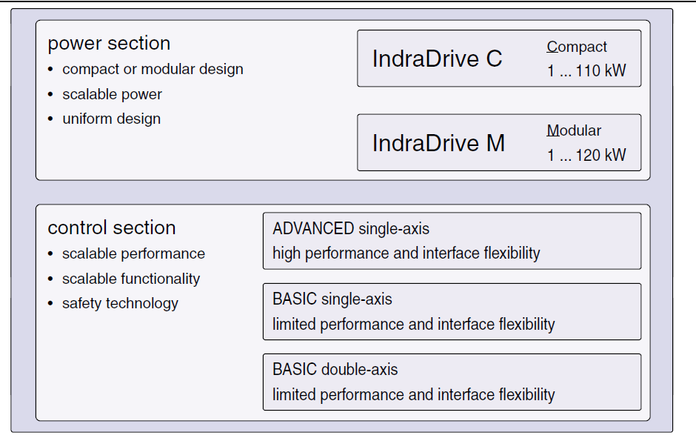

Slide 31
Drive basic Configuration:
The drive basically consists of three sections. They are,
Power section
Control section
Firmware section
Features of new MMN drives,
SERCOS II(optic fibre)
LCD display with controls.
Common DC bus

Slide 32
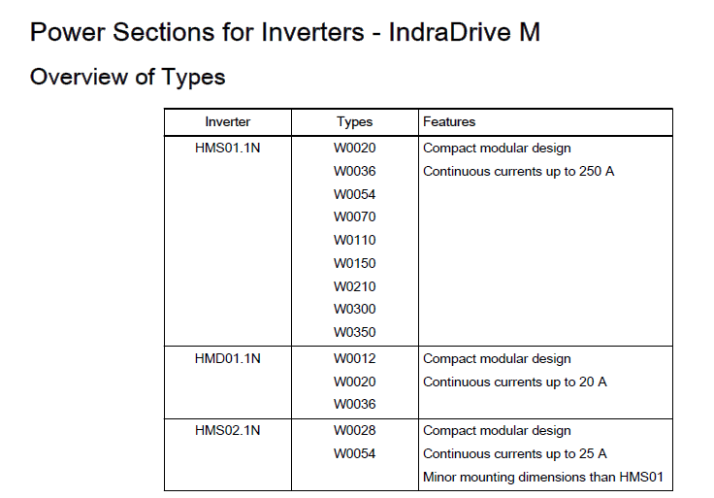
Power Section Types:

Slide 33
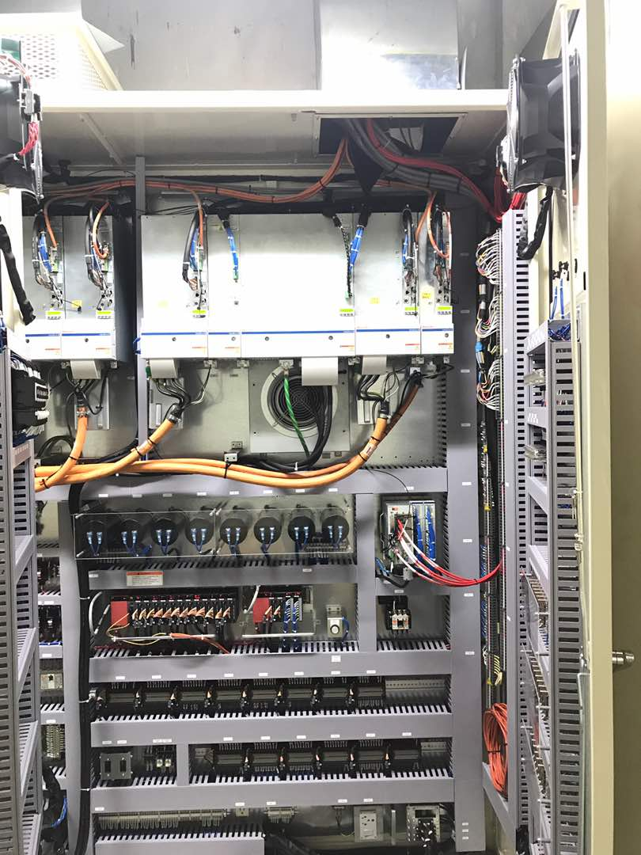

Slide 34
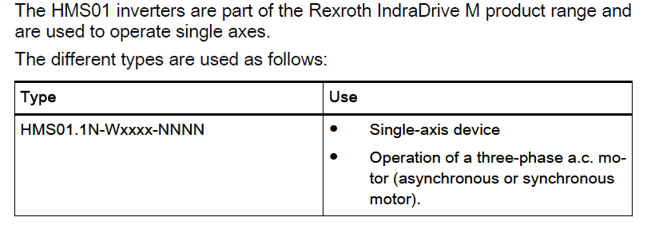
HMS01 Drive:
Drives are mainly used for achieving speed and phase synchronization.

Slide 35
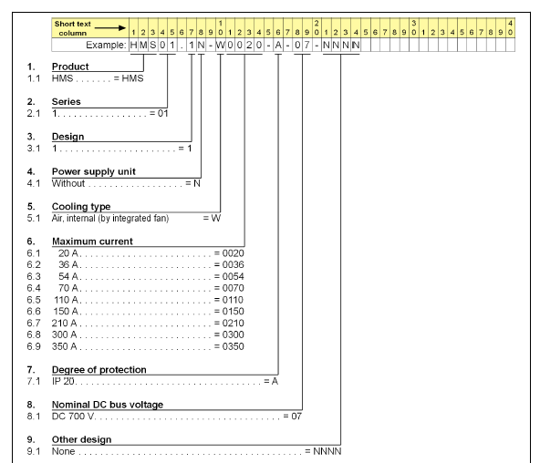
Type Code:

Slide 36
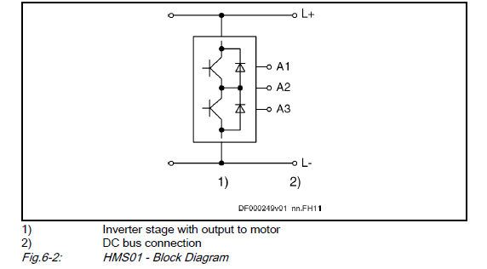
HMS power section:

Slide 37
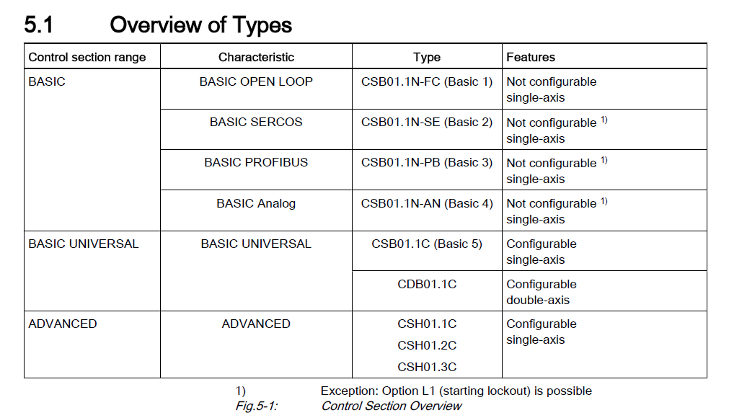
Control Section:

Slide 38
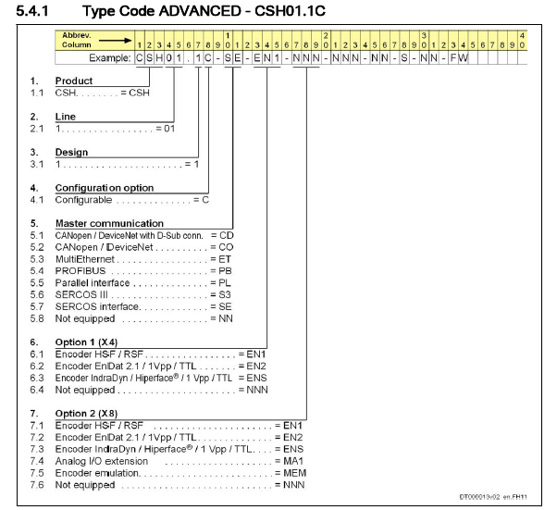

Slide 39
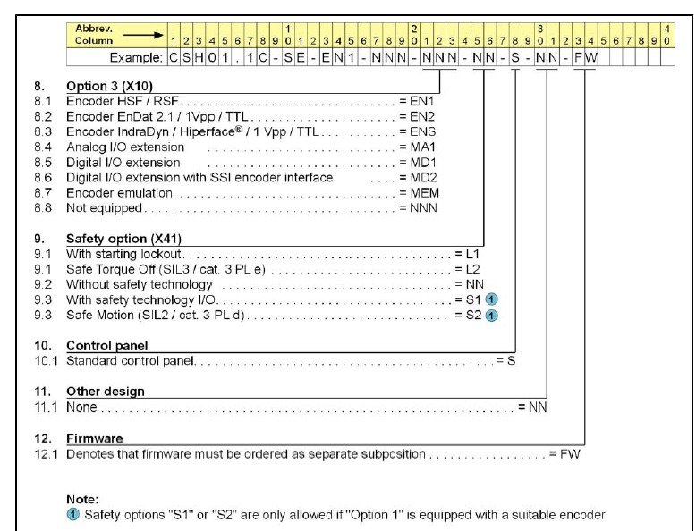

Slide 40
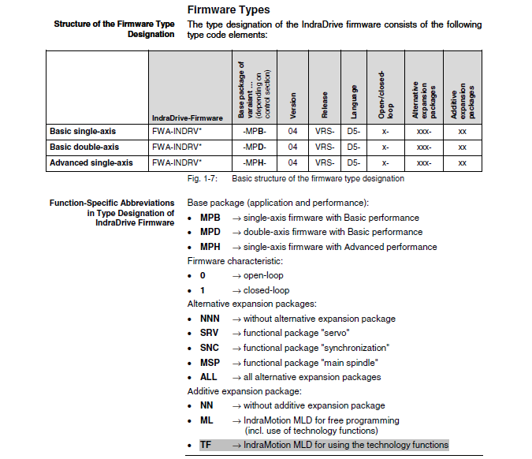

Slide 42
Softwares Used:
Software used are as follows,
Syntop 13 V8
Indra works
Parameters can be viewed and downloaded using syntop 13 s/w.
Oscilloscope function is done using Indra works s/w.

Slide 43
Parameter Backup:
Open and configure SCP configurator for respective PPC-R.
Once configured, directly connect to Motion Control. Thus, online connection is established.
Then use the option Load/save parameter to upload/download the parameters from PPC-R.
You can download S/P parameters individually.

Slide 44
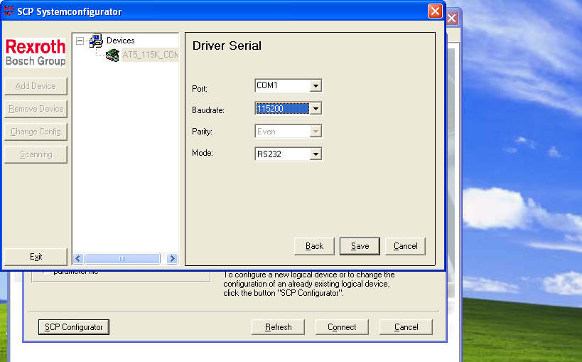
SCP configurator:

Slide 45
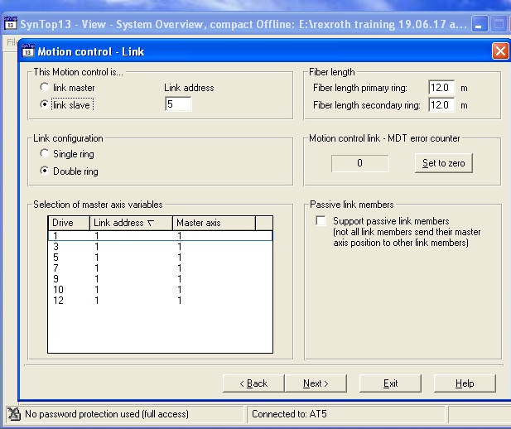
Optic Fibre Intensity adjustment:
SERCOS Primary/Secondary LOOP adjustment
Inner Loop adjustment in LED display(Drive to Drive)
1. press and hold both esc and enter key for 8 seconds
2.Press up arrow. command screen will appear
3. Press Enter
4.Press Up arrow. 2.2 screen will appear
5.Press Enter. P4027 will appear. Press enter
6. default setting will be 15..30m
7. Press up or down button to increase or decrease
8. Highest value is >45m. So once the range is selected press enter.
9.Press esc to main screen

Slide 46
Encoder oscilloscope function:
By using the oscilloscope function, the graphical representation for each parameter can be drawn.
Open Indraworks s/w
Select Diagnosis/service---->oscilloscope function in the appeared screen.
Add parameters from the list of S and P Parameters.
Triggering signal can be manual or Signal form.
Uses of Oscilloscope function,
Encoder Signal strength check
Graphical representation for diagnosis

Slide 47
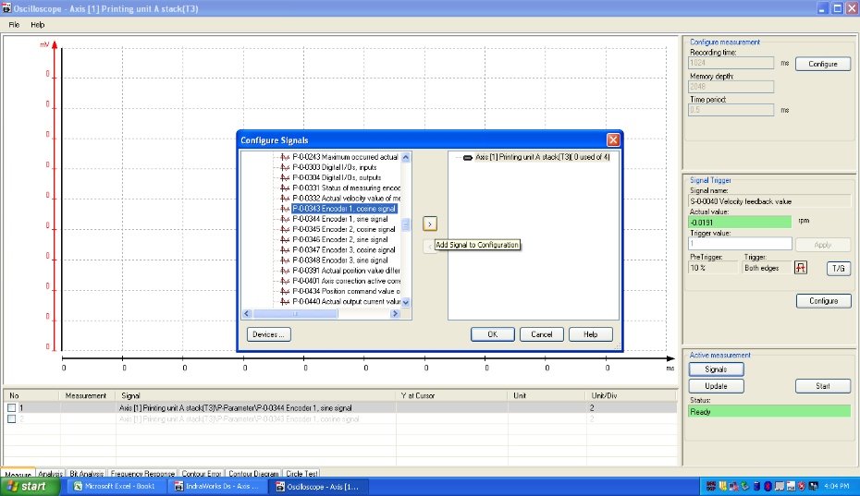
Oscilloscope Function:

Slide 48
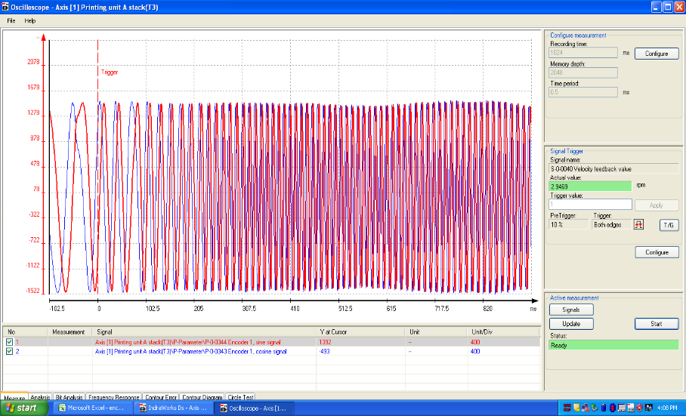
Sample Graph:

Slide 49
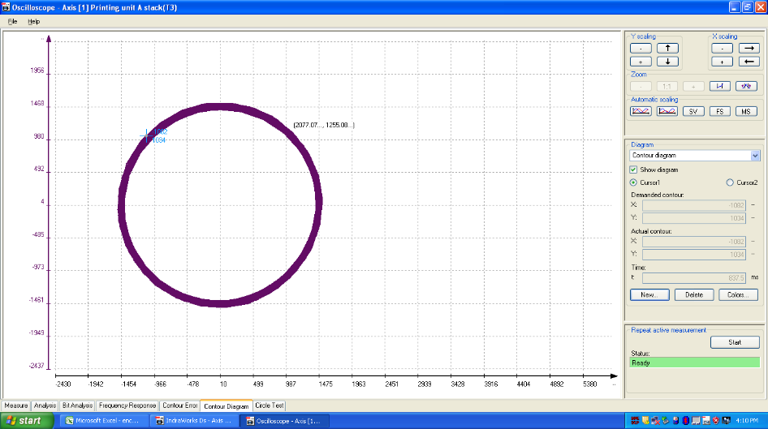
Encoder Signal Strength:
X coordinate-Sine signal
Y coordinate-Cosine signal
Shape
Round-Good
Elliptical-Bad

Slide 50
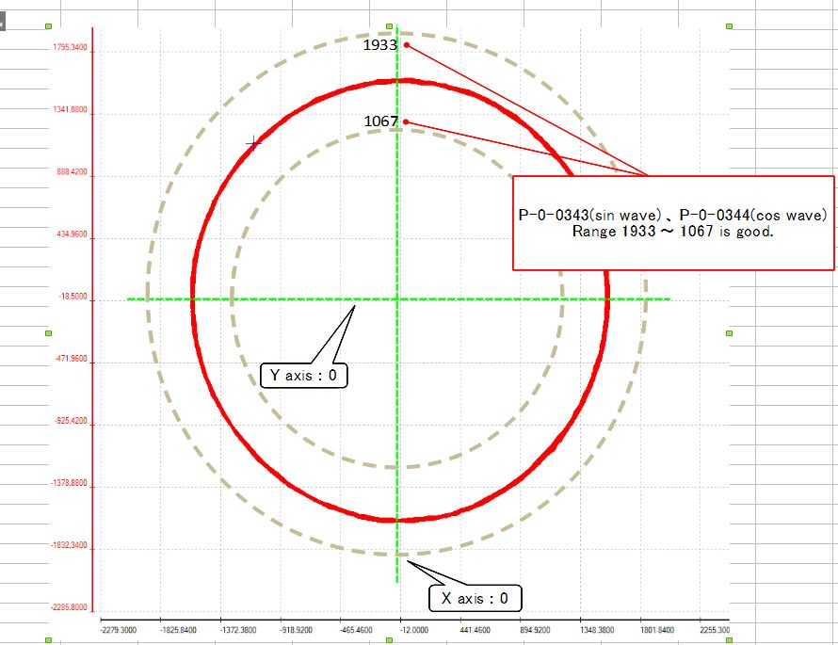
Encoder Lissajous wave form decision criteria:

Slide 51
Question and Answer threads
B link register only modified, W word register not modified.
Idea to replace broken thermistor was discussed.
Gain adjustment and homing adjustment for drives was discussed.
Fibre optic measurement should be taken at 650nm wavelength. Range is –20dB for Primary, secondary and inner loop also.
PLC modified Program list with backup was given.

Slide 52
Thank you

